Slide 1
Brand Guidelines
August 2023

Slide 2
Introduction
This is the official Living Security brand guidelines manual.
Our goal is to outline the marketing and communication efforts that will be consistently used as we continue to help business grow and develop top talent and high performing teams.
WHY IS BRANDING SO IMPORTANT?
The Living Security brand represents who we are and what we stand for each and every day. Maintaining brand consistency is imperative for presenting a cohesive, unified image to both internal and external audiences.
Contents:
The Brand
The Living Security Brand Story
Visual Identity
Logo
Color Pallette
Type & Fonts
Imagery
#5
#6
#8
#10

Slide 3
Visual Identity

Slide 4
The Logo
We are proud of our logo, and we require that you follow these guidelines to ensure it is aligned with our uniform brand image.
Living Security Brand Guidelines
Updated October 2021 | LivingSecurity.com

Slide 5
Logo Variations
PRIMARY LOGO
Use the primary logo when possible in either the horizontal or stacked version.
PRIMARY REVERSE
When designing with dark backgrounds such as a solid color or on top of a photograph, use the reverse version of the the primary mark.
Tip: If the layer underneath the logo does not provide enough contrast for the blue icon, default to the one color “white” version.
ONE COLOR OPTIONS
These versions of the logo should be used when color is not an option, or when the logo will be placed on complex / colorful backgrounds.
Primary Logo
Primary Logo Reverse
One Color Variants
Living Security Brand Guidelines
Updated October 2021 | LivingSecurity.com

Slide 6
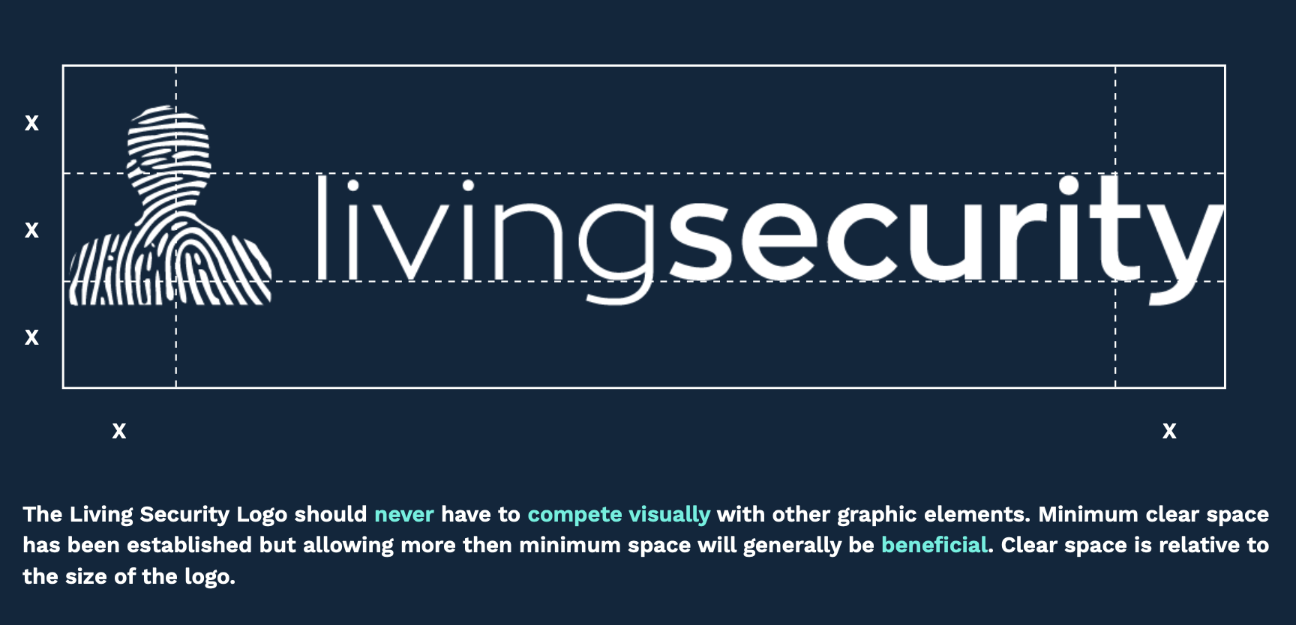
Clear Space

Slide 7
Color Pallette (LIGHT MODE)
Living Security is energizing, insightful, relatable, and cutting- edge. The goal of the color palette is to capture this feeling while projecting a clear brand identity.
PRIMARY COLORS
Our primary colors are Fog of War and Tiber.
ACCENT COLORS
Ice Climber and Deep Pink are accents. Ice Climber can be used at 20% and Deep Pink should be more conservative at 5% ie: CTA buttons.
SECONDARY COLORS
We leverage our secondary colors to infuse energy and additional colors needed for imagery used to complement our primary colors.
PRIMARY COLOR PALETTE
ACCENT COLOR PALETTE
White Text
White Text
Fog of War Text
White Text
Fog of War
#0C273D
Tiber
#164045
Ice Climber
#2EF2DF
Deep Pink
#FF087F
SECONDARY COLOR PALETTE
TERTIARY COLOR PALETTE
White Text
White Text
White Text
White Text
Dark Cerulean
#0C5B75
Elf Green
#1F8D66
Bondi Blue
#0B8FAD
Kelly Green
#52BE27

Slide 8
Color Pallette (DARK MODE)
Living Security is energizing, insightful, relatable, and cutting- edge. The goal of the color palette is to capture this feeling while projecting a clear brand identity.
PRIMARY COLORS
Our primary colors are Fog of War and Tiber.
ACCENT COLORS
Ice Climber and Deep Pink are accents. Ice Climber can be used at 20% and Deep Pink should be more conservative at 5% ie: CTA buttons.
SECONDARY COLORS
We leverage our secondary colors to infuse energy and additional colors needed for imagery used to complement our primary colors.
PRIMARY COLOR PALETTE
ACCENT COLOR PALETTE
Fog of War Text
White Text
White Text
White Text
Fog of War
#0C273D
Tiber
#164045
Ice Climber
#2EF2DF
Deep Pink
#FF087F
SECONDARY COLOR PALETTE
TERTIARY COLOR PALETTE
White Text
White Text
White Text
White Text
Dark Cerulean
#0C5B75
Elf Green
#1F8D66
Bondi Blue
#0B8FAD
Kelly Green
#52BE27

Slide 9
Types and Fonts
The primary typeface used for the
Living Security brand is “Work Sans”.
The Normal weight and others in the middle of the family are optimized for on-screen text usage at medium- sizes (14px-48px) and can also be used in print design. The fonts closer to the extreme weights are designed more for display use both on the web and in print.
Adhering to a set of guidelines for font usage helps create visual consistency.
Work Sans Bold
ABCDEFGHIJKLMNO PQRSTUVWXYZ abcdefghijklmno pqrstuvwxyz 1234567890
!@£$% &*()+ -–—“” ‘’?/
On the web and in print this weight is great for headlines and in short blocks of text you would like to draw attention to.
Work Sans Regular
ABCDEFGHIJKLMNO PQRSTUVWXYZ abcdefghijklmno pqrstuvwxyz 1234567890
!@£$% &*()+ -–—“” ‘’?/
Best font weight for body text

Slide 10
Web Use
HEADLINE 1 - BOLD WEIGHT, Title Case in AP Style
Security Awareness Training Has Two Fundamental Problems
HEADLINE 2 - SEMI BOLD WEIGHT
Security Awareness Training Has Two Fundamental Problems
HEADLINE 3 - SEMI BOLD WEIGHT
Security Awareness Training Has Two Fundamental Problems
PARAGRAPH - NORMAL WEIGHT, Sentence case
Security Awareness Training has two fundamental problems.
BULLETS- NORMAL WEIGHT, Sentence case
Security
Awareness
Training
Adhering to a set of guidelines for font usage helps create visual consistency. At right is an example of the hierarchy that should be maintained when implementing or creating written content.
The varying sizes and colors of headlines can help break up longer blocks of text making it easier for the user to read or skim.
“Work Sans” can deployed on a website via Google Fonts in a range of weights and styles.
Living Security Brand Guidelines
Updated October 2021 | LivingSecurity.com

Slide 11
Imagery: People
Our photography is informed by the subjects at the center of our business: people and technology. As a human risk management platform, our focus is solving for the human element of cybersecurity and our photographic style should reflect this.
Photography can be sourced from stock providers such as Unsplash or Adobe Stock. Please use the following guidelines when designing with photos:
Wide shots should feature teams working in close collaboration
Close up, “over the shoulder” shots should focus on the connectedness between a person and computer
Photos showing various genders and ethnicities are used
Living Security Brand Guidelines
Updated October 2021 | LivingSecurity.com

Slide 12
Visual Styling Examples

Slide 13
Visual Styling Examples

Slide 14
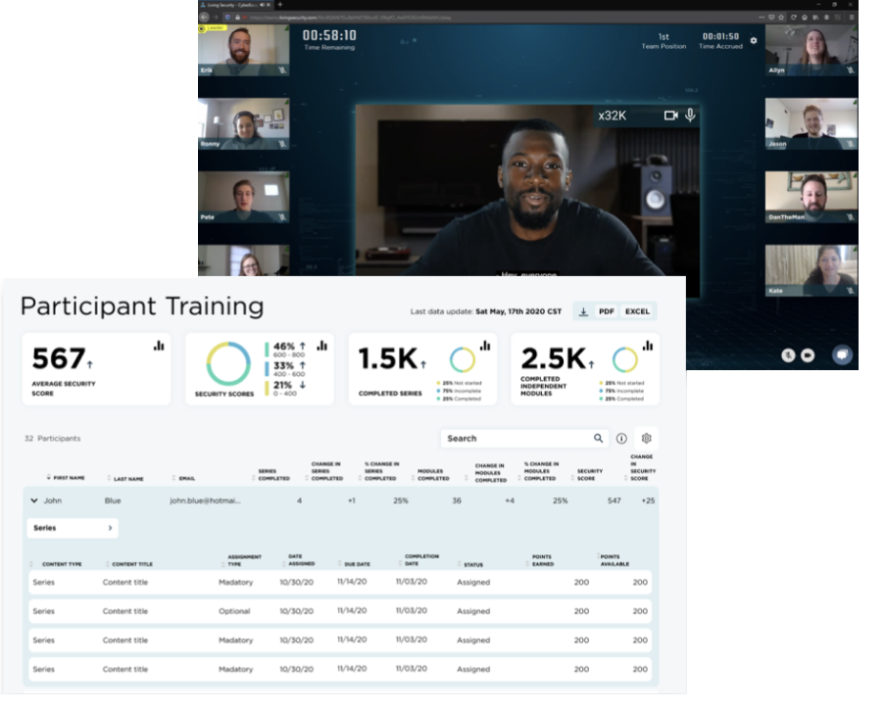
Imagery: Product
Living Security products are the result of countless hours of research and hard work. When writing about our human risk management platform be sure to include appropriate images in your design.
Let the product shot speak for itself.
Product images should be free from unnecessary markups or cropping and should only be edited to obscure private information where applicable.

Slide 15
Iconography System
Full Icon System png/svg here: https://drive.google.com/drive/folders/1mCGkaNQxuj6zrkGLJm91e8aRBxS_MM7f?usp=share_link
Notes:
More icons here: https://remixicon.com/

Slide 16
Iconography System
Full Icon System png/svg here: https://drive.google.com/drive/folders/1mCGkaNQxuj6zrkGLJm91e8aRBxS_MM7f?usp=share_link
Notes:
More icons here: https://remixicon.com/

Slide 17
Diagram Visual Style
The goal of any of our diagrams should be to clearly articulate the message to the audience. Whether used on the website, white paper, or in a presentation, diagrams should have consistent color and icon usage.

