Slide 1

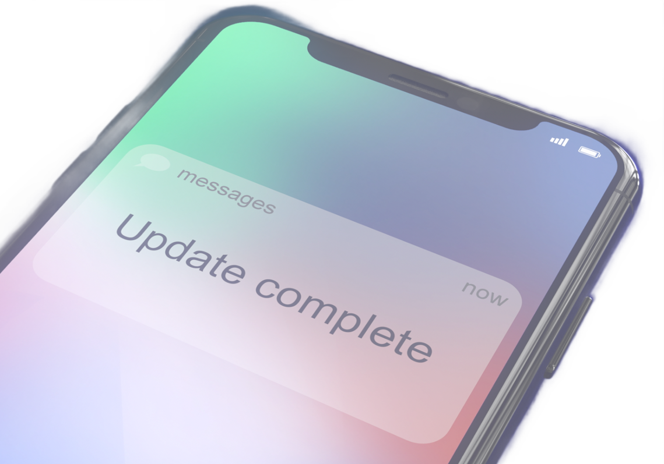

HERE ARE SOME TRICKS
for remembering to update your devices:
Set a CALENDAR REMINDER for the end of the day after being prompted to update.
Make it a habit to CHECK FOR UPDATES every Friday at the end of the day.
SET AN ALARM for your lunch break so updates can install while you eat.
Attach a STICKY NOTE to your device that reminds you of the update.

