Slide 1

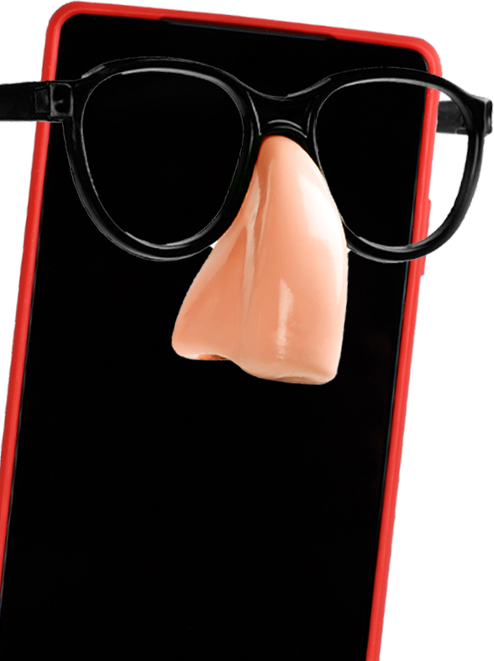

COMMON SOCIAL ENGINEERING TACTICS
CURIOSITY: That mysterious flash drive might have malware. Best not to plug it in!
BAITING: A free cruise would be nice, but it's probably too good to be true
THREATS: If this is the first you're hearing about your unpaid taxes, it's probably extreme to be threatening legal action. Verify that sender

