Slide 1

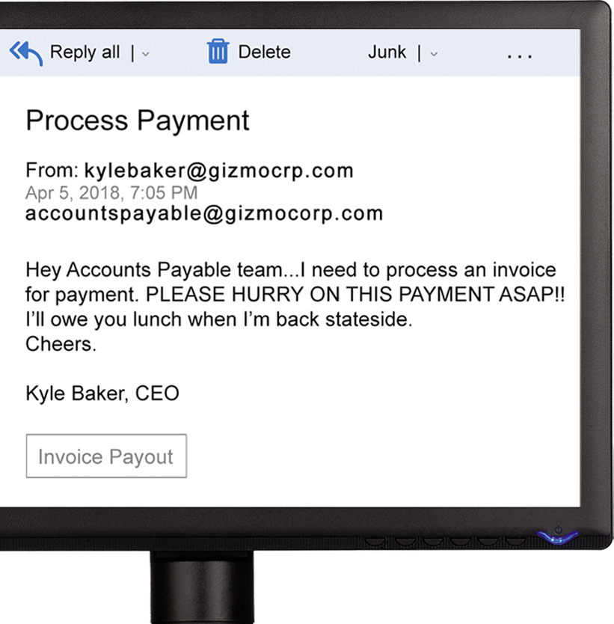

SEE SOMETHING PHISHY?
when you’re confronted with a message that seems a little off, don’t just delete it!
NOTIFY THE SECURITY TEAM so that we can all help keep each other safe as a team.

