Slide 1

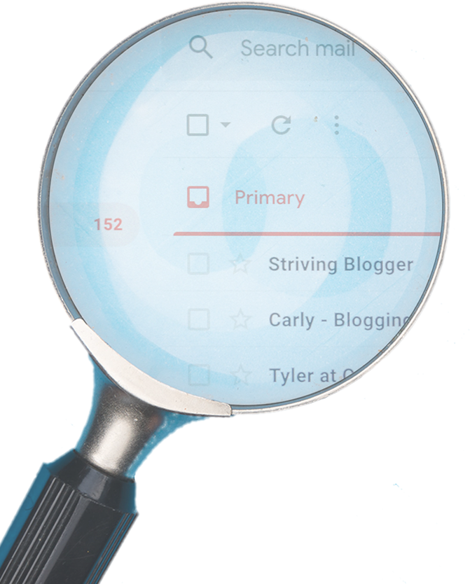

HOW CAN YOU STAY VIGILANT?
VERIFY the sender’s identity through another form of contact
Be wary of SUSPICIOUS links and attachments
If an email looks strange,
REPORT IT!
LOOK OUT for unnecessary urgency
DON’T REPLY to suspicious emails
TRUST your gut

