Slide 1

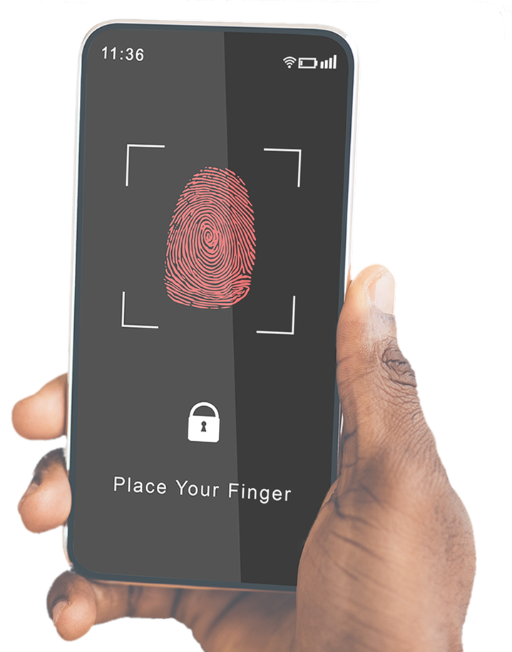

SECURITY QUESTIONS
can help protect your accounts, but try to AVOID USING answers that can be found through your Facebook, LinkedIn or other social media accounts

