Slide 1

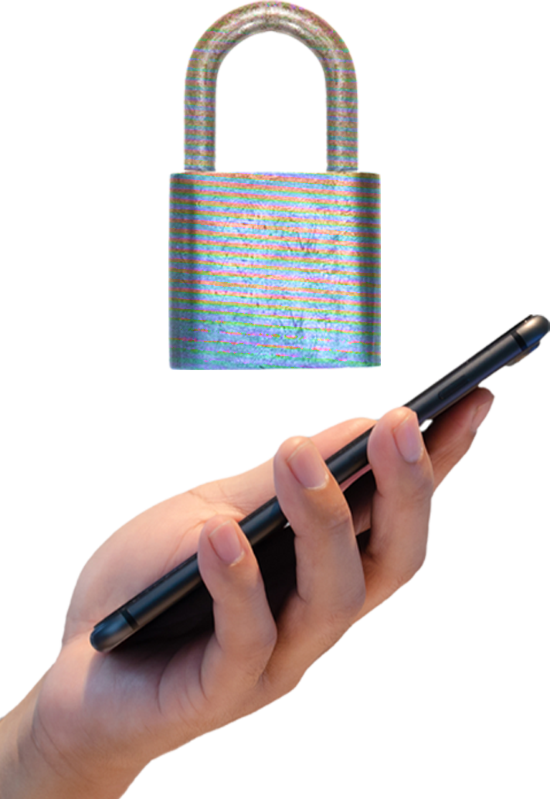

BE CAREFUL
of the 2 types of phish that specifically target your phone: SMISHING and VISHING
The BIGGEST RED FLAG for these is that they often come with a sense of urgency. When in doubt, trust your gut!

