Slide 1

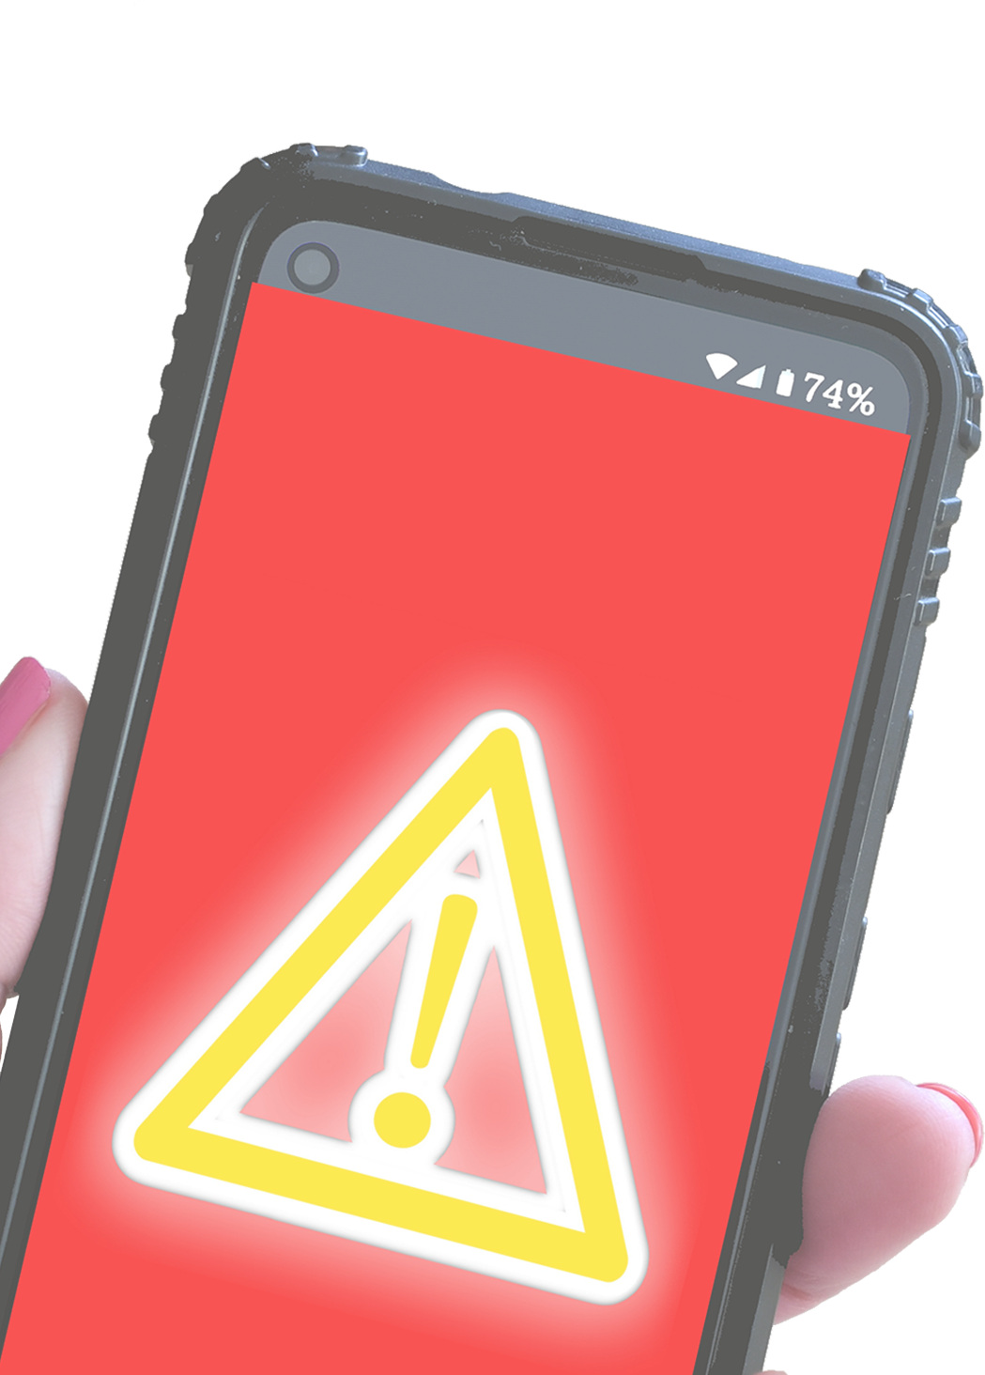

BEST PRACTICES
Don’t click on SUSPICIOUS LINKS or download files from UNKNOWN SOURCES
Keep your device UP TO DATE
Run a DIAGNOSTIC SCAN on your computer at least once a week

