Slide 1

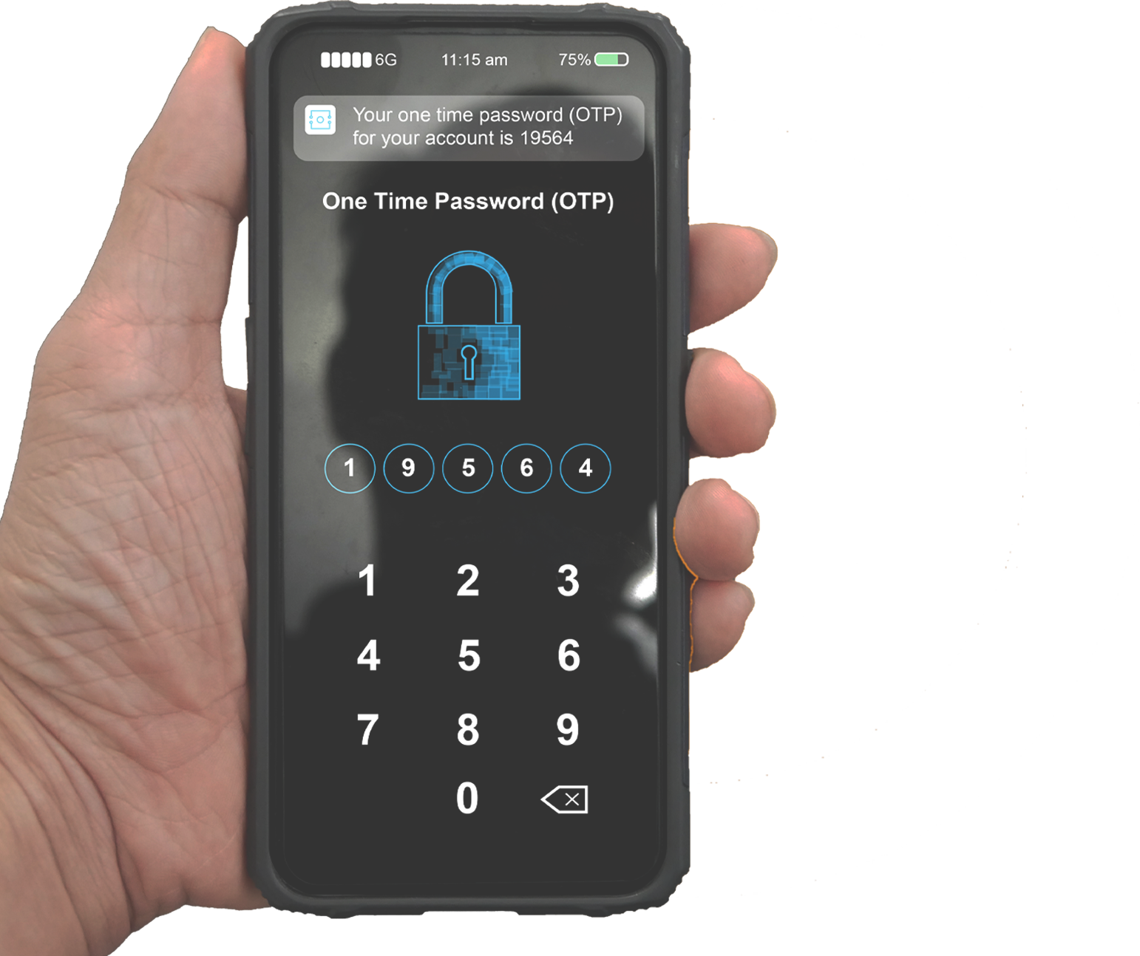

ONE-TIME PASSCODES
are one of the MOST COMMON forms of MFA. The user receives a code through EMAIL, TEXT, or MOBILE APP they can use for authentication.

