Slide 1



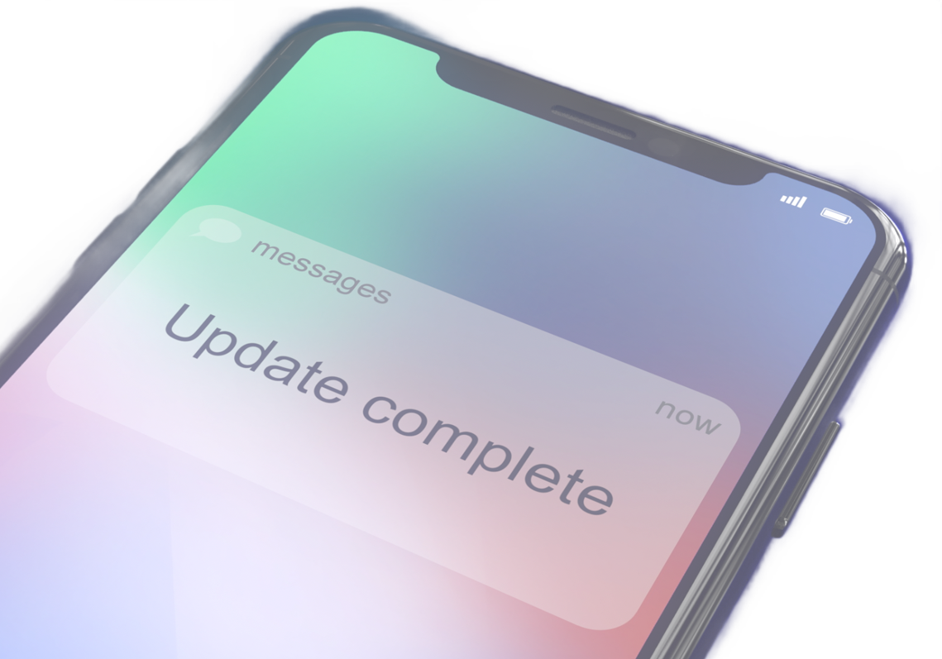

UPDATES
ARE YOU UP TO DATE?
Updates aren't just for your computer. Look out for updates for:
IOT DEVICES, like virtual assistants and smart devices
MOBILE DEVICES like cellphones and tablets
COMPUTERS, both personal and work-related
APPS & PROGRAMS that run on any device
Even INTERNET ROUTERS should be updated every so often
HERE ARE SOME TRICKS
for remembering to update your devices:
Set a CALENDAR REMINDER for the end of the day after being prompted to update.
Make it a habit to CHECK FOR UPDATES every Friday at the end of the day.
SET AN ALARM for your lunch break so updates can install while you eat.
Attach a STICKY NOTE to your device that reminds you of the update.
SECURITY BOOSTS
may be the MOST IMPORTANT reason to update your software and devices, but they’re not the only reason:
Updates can IMPROVE your user experience. Exciting new features, extended emoji libraries, and UI improvements
Software updates also help programs STAY COMPATIBLE with your operating system by making adjustments to its processes.

