Slide 1
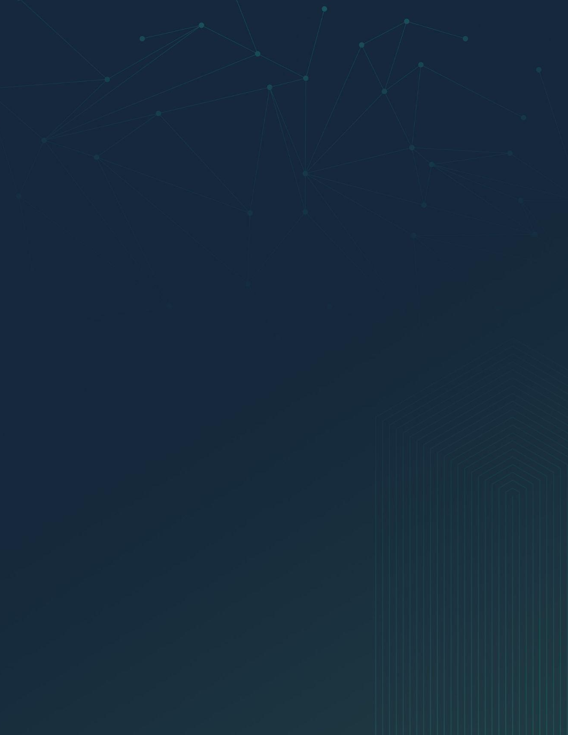
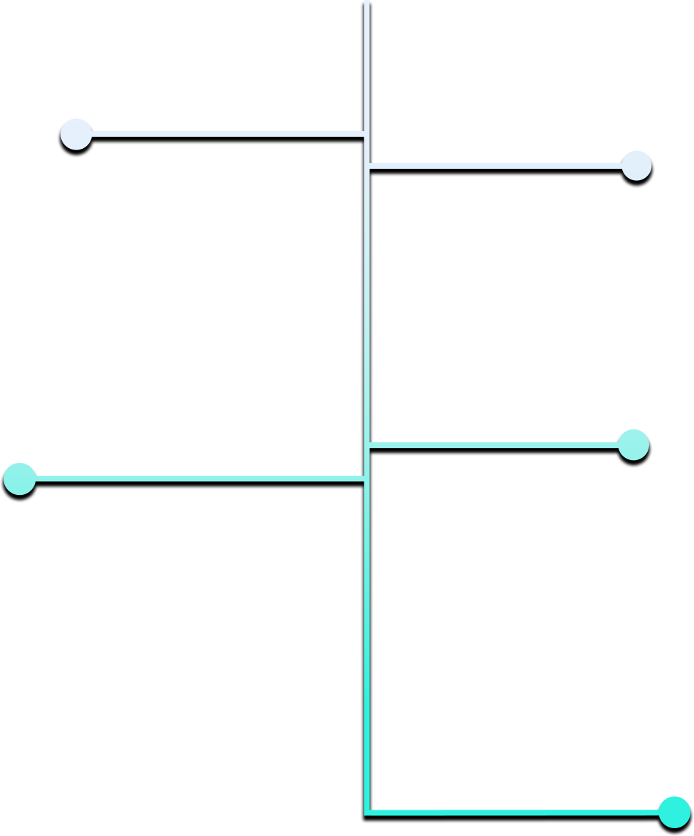

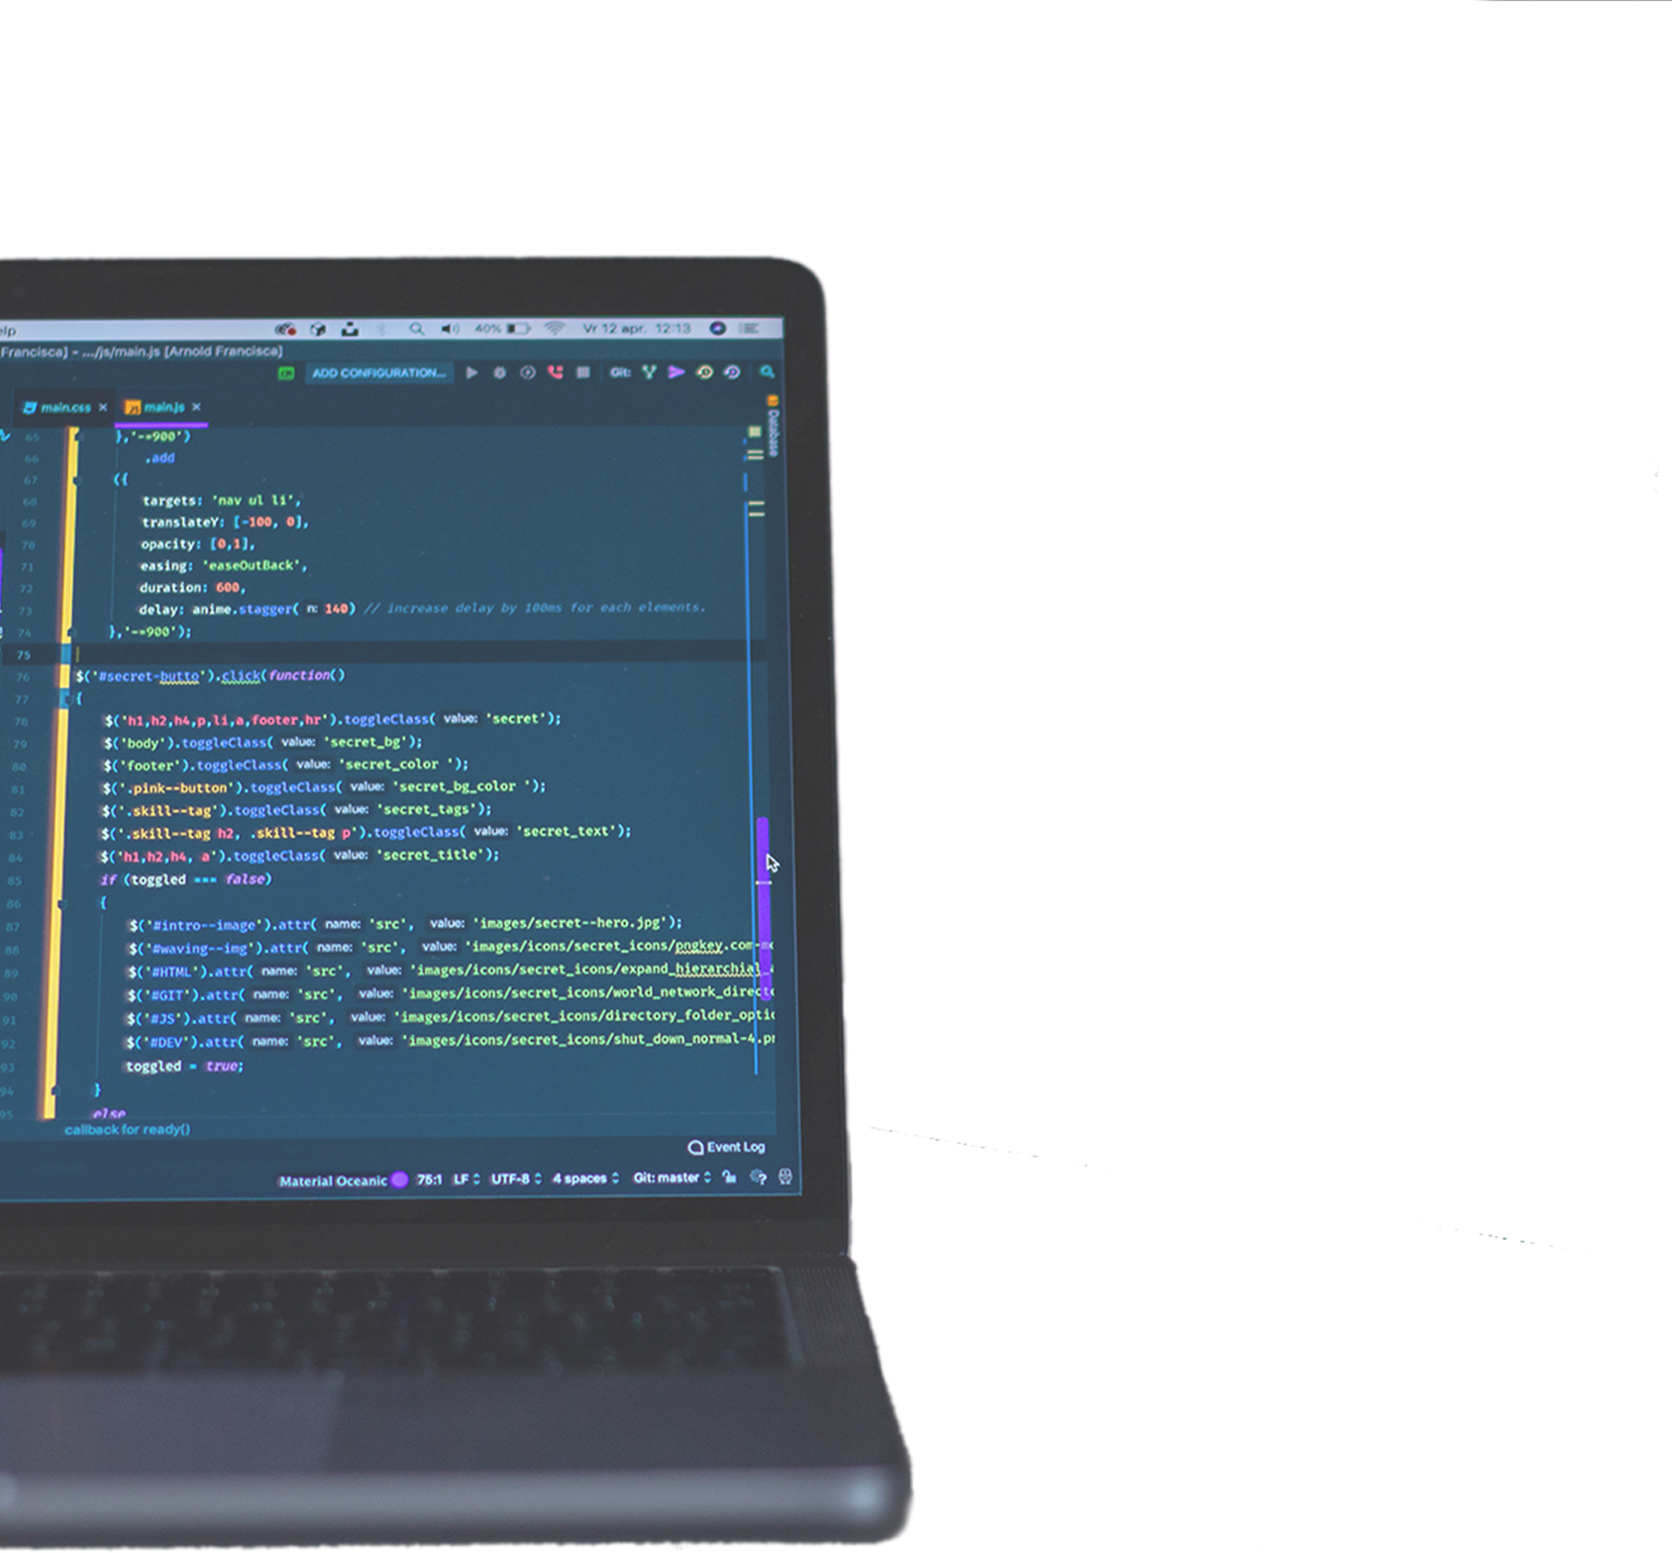

SECURE CODING
HERE’S A LOOK INTO THE MOST COMMON APPLICATION VULNERABILITIES THAT MADE
OWASP 2021 TOP 10:
INJECTIONS
BROKEN ACCESS CONTROL
Injections happen when a MALICIOUS USER inputs specially crafted text that interrupts the normal execution of a program, query, or OS command to steal and destroy data. ALWAYS parameterize your queries, decouple user inputs from file system paths, sanitize user input, and maintain diligent code review.
When developing your code, authentication and access restriction need to be PROPERLY IMPLEMENTED and TESTED. Don’t underestimate the strength of TIGHTLY LOCKED administrative accounts.
CRYPTOGRAPHIC FAILURES
SECURITY
MISCONFIGURATION
This category often leads to sensitive DATA EXPOSURE or SYSTEM COMPROMISE. When creating secure code, you want to INCLUDE STRONGER FEATURES to protect sensitive and regulated data.
Static application security testing (SAST) is not a nice-to-have; IT’S A MUST. This testing can help you detect XML in source code, inspecting third-party components with known vulnerabilities, as well as application configuration and dependencies.
INSECURE
DESIGN
DON’T WAIT to find vulnerabilities during penetration tests; INCORPORATE application scanning early and test the resiliency of the code from the start. You need to diligently make security a PRIORITY within your initial design and application testing.

