Slide 1

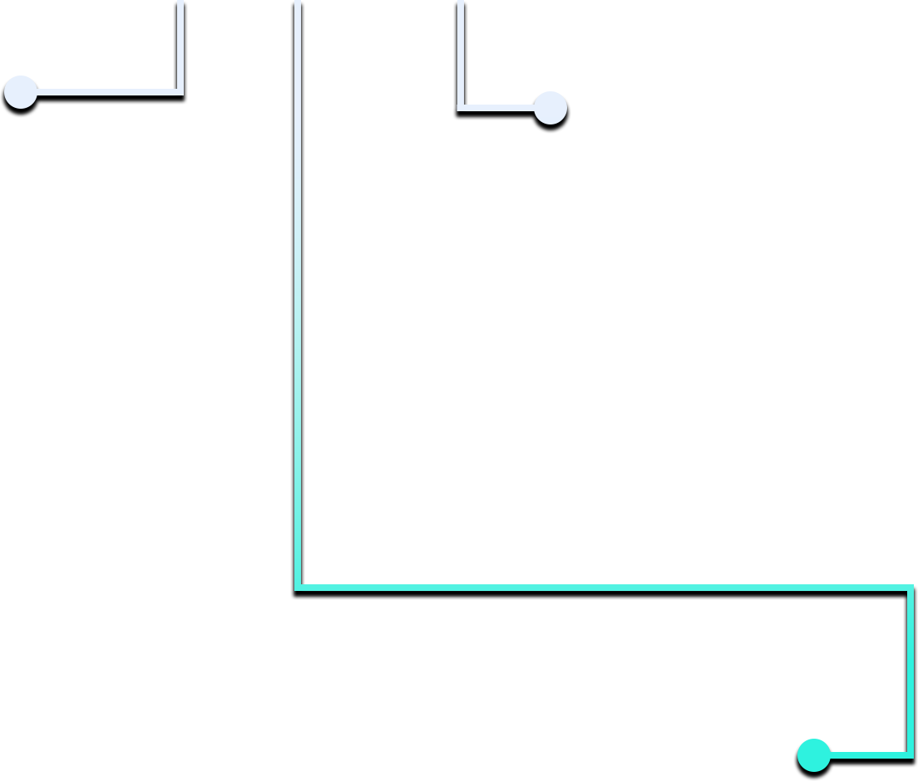


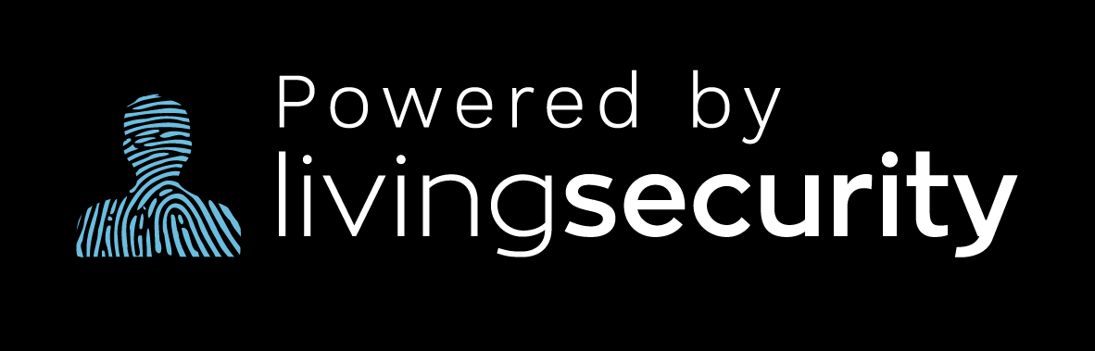
PRIVACY
HOW IS MY DATA BEING USED?
OVERSHARING
BROWSING DATA helps websites give you personalized content recommendations
DEMOGRAPHIC & ACTIVITY DATA is used to show you targeted ads
Your EMAIL ADDRESS can be sold to a third party, often resulting in email spam
LEAKED PII (Personally Identifiable Information) can be used to commit fraud
on social media can lead to loss of control over your data. Here’s how you can PROTECT your privacy:
CONTROL who sees your posts and info
CHECK which apps monitor and access your social media platforms
SET UP multi-factor authentication (MFA) in the event you get hacked
DIGITAL IDENTITY THEFT
was one of the 3 MOST COMMON
forms of cybercrime in 2021.
WHAT CAN I DO?
U.S. Federal Trade Commission
ADJUST your privacy settings
REMOVE old, unused applications from your devices
UNDERSTAND that personal data has high value

