Slide 1



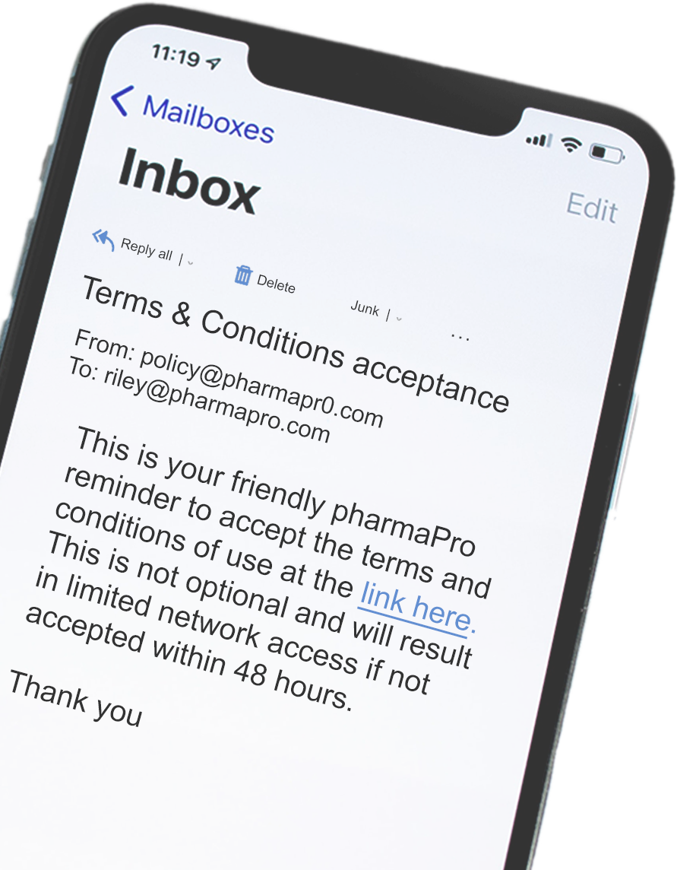

PHISHING
Over
36%
3.1 BILLION
spoofed emails are sent every day
PHISHING
of security breaches
were the direct result of
phishing attacks
doesn’t just happen in your
email inbox:
SMISHING occurs via text message
Verizon 2021 Data Breach Investigation Report
VISHING happens through phone call
SOCIAL MEDIA PHISHING happens on social media platforms
ON THE HOOK?
HOW CAN YOU
STAY VIGILANT?
Here’s what you need to do if a phisher gets you on their line:
VERIFY the sender’s identity through another form of contact
Be wary of SUSPICIOUS links and attachments
If an email looks strange,
REPORT IT!
LOOK OUT for unnecessary urgency
DON’T REPLY to suspicious emails
TRUST your gut
REPORT it to IT or
your security team
CHANGE your login information for any compromised accounts

