Slide 1



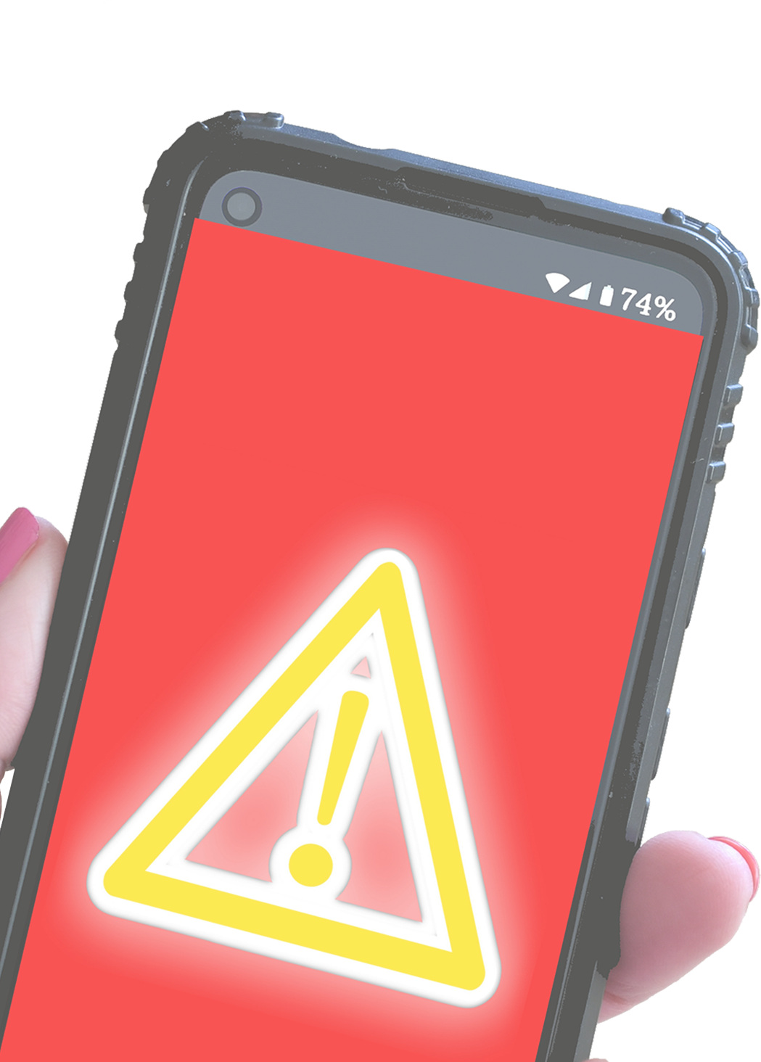

MALWARE
Globally, malware takes a
MALWARE
$1 TRILLION
Infects your device to SPY on you, STEAL your information, DESTROY your files, or otherwise WREAK HAVOC
toll every year!
Malware doesn’t just infect computers. It can infect PHONES, TABLETS, and any device CONNECTED TO THE INTERNET or
DISCOVERABLE VIA BLUETOOTH
PROTECT YOUR MONEY
Malicious code known as E-SKIMMERS may steal your card information when online shopping, even on trusted websites
SIGNS
OF MALWARE
DEVICE runs slower than normal
Browser REDIRECTS you to sites you didn’t want to visit
Messages appear from FAKE ANTIVIRUS software
System tools or settings are DISABLED
Battery life is SHORTENED
The safest checkout methods are the ones that DON’T REQUIRE you to enter your card information, such as Paypal or Apple Pay
BEST PRACTICES
Don’t click on SUSPICIOUS LINKS or download files from UNKNOWN SOURCES
Keep your device UP TO DATE
Run a DIAGNOSTIC SCAN on your computer at least once a week

