Slide 1



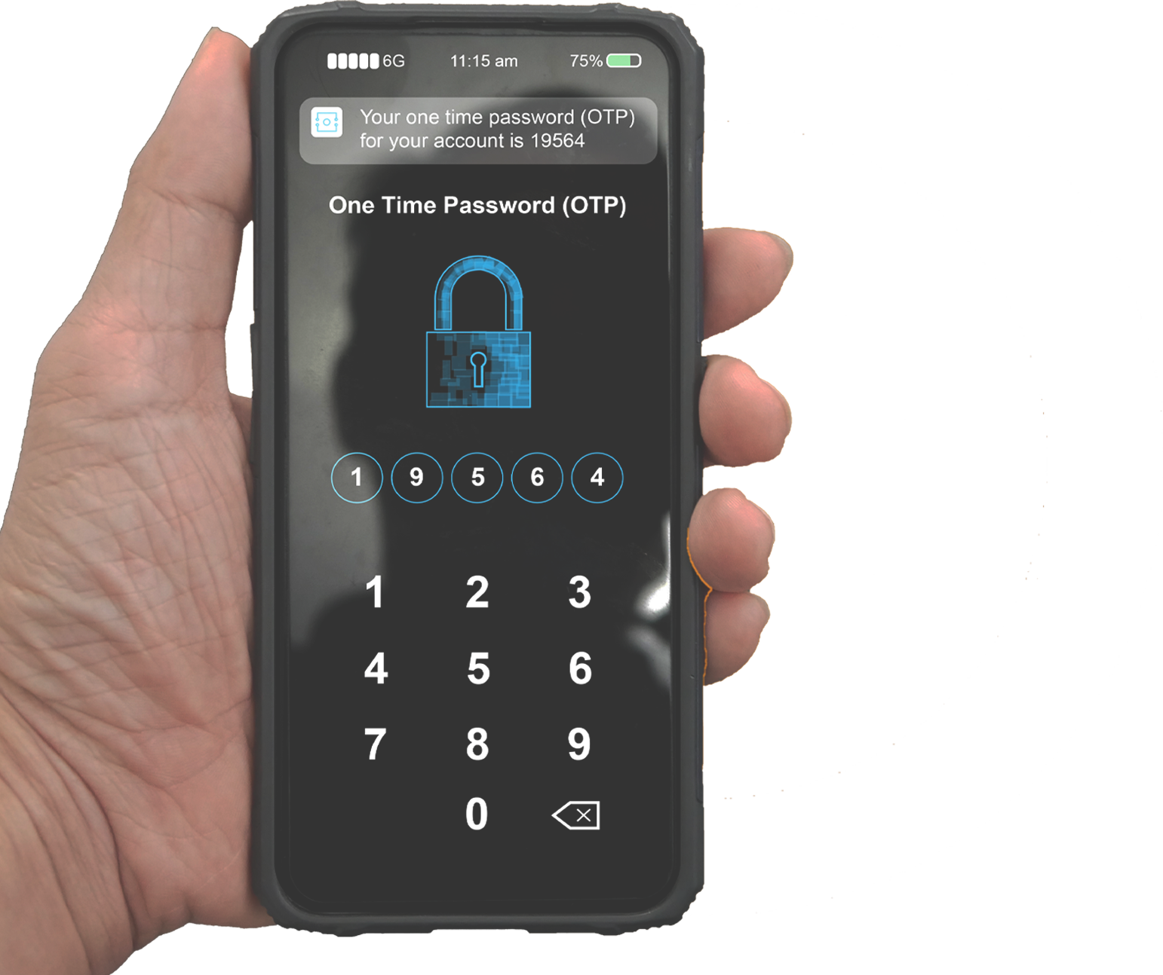

MULTI-FACTOR
AUTHENTICATION
MULTI-FACTOR
AUTHENTICATION (MFA)
requires a user to VERIFY their identity in more than one way in order to sign in to an account.
MFA protects accounts from UNAUTHORIZED ACCESS even if a password is compromised.
ONE-TIME PASSWORDS
Types of MFA include:
are one of the MOST COMMON form of MFA. The user receives a code through EMAIL, TEXT, or MOBILE APP they can use for authentication.
Something you KNOW…
...like a PASSWORD
Something you HAVE…
...like a PHONE NUMBER
Something you ARE…
...like a FINGERPRINT
DID YOU KNOW?
In MFA FATIGUE ATTACKS, cybercriminals send an authentication request to a user's phone using a PUSH NOTIFICATION repeatedly until the user authenticates the login attempt.

