Slide 1



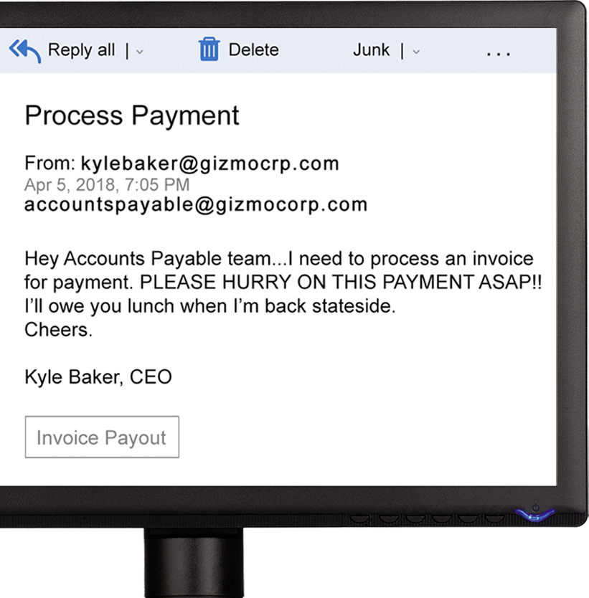

PHISHING
PHISHING
comes in all shapes and sizes:
VISHING happens through phone calls
SMISHING occurs via text message
SOCIAL MEDIA & ANGLER PHISHING involve spoofing profiles and pretending to be someone else or a representative of a company
CLONE PHISHING copies real emails and swaps out legitimate links for malicious ones
WHAT TO LOOK OUT FOR:
DOUBLE-CHECK the sender’s email address. Does it seem right for who the sender is claiming to be?
HOVER over any links. Do they lead to a trustworthy, familiar webpage?
If there’s an ATTACHMENT, were you expecting it? Does the file extension make sense (.pdf, .exe, etc.)?
Are they asking for SENSITIVE INFORMATION?
Are there spelling or grammatical ERRORS?
Not all phishing emails will contain these mistakes, but it can be a warning sign.
SEE SOMETHING PHISHY?
when you’re confronted with a message that seems a little off, don’t just delete it!
NOTIFY THE SECURITY TEAM so that we can all help keep each other safe as a team.

