Slide 1


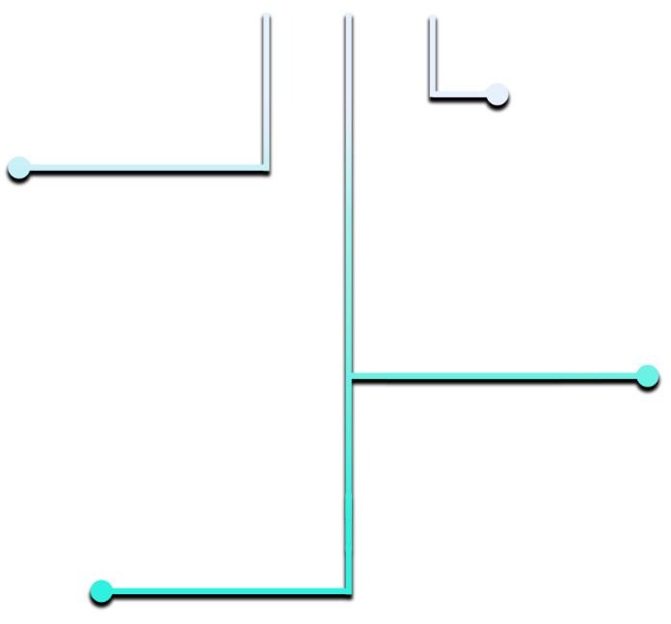
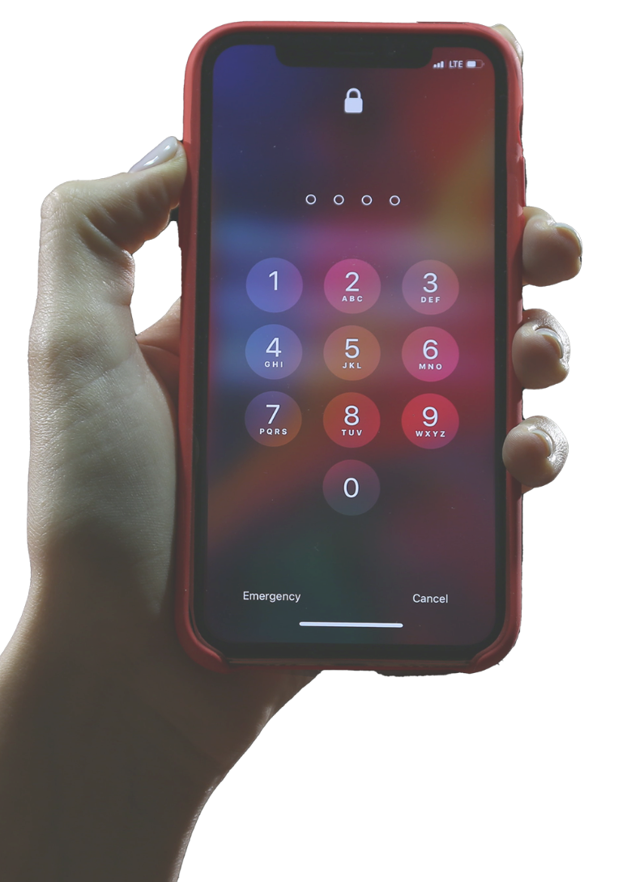
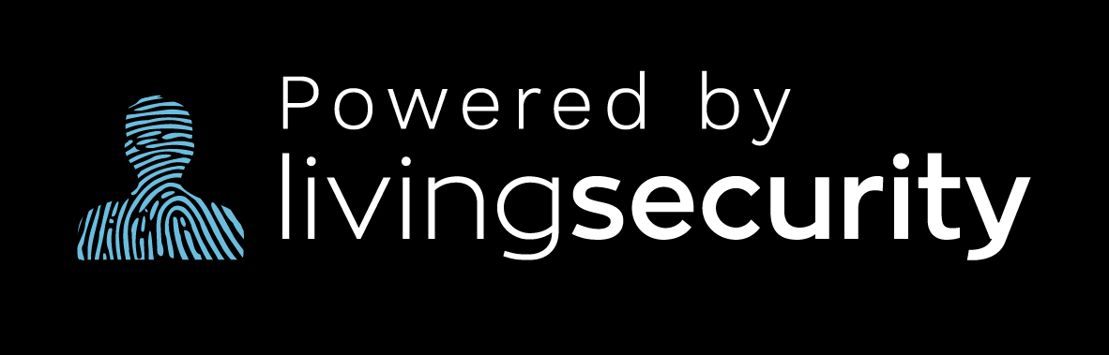
PASSWORDS
DID YOU KNOW?
QUICK TIPS
The average user owns over
90 ACCOUNTS
and each should have a unique password. Can’t remember them all? Try a PASSWORD MANAGER or easy-to-remember passphrases.
for better, more secure passwords:
NEVER reuse passwords
CREATE long, strong passwords using letters, numbers, and special characters
PASSPHRASES are a great way to remember passwords that are long and unique
DON’T share your passwords with other people
SECURITY QUESTIONS
can help protect your accounts, but try to AVOID USING answers that can be found through your Facebook, LinkedIn or other social media accounts
MULTI-FACTOR
AUTHENTICATION (MFA)
keeps cybercriminals out of your account by verifying your identity using more than one of the following:
Something you KNOW…
...like a PASSWORD
Something you HAVE…
...like a PHONE NUMBER
Something you ARE…
...like a FINGERPRINT

