Slide 1



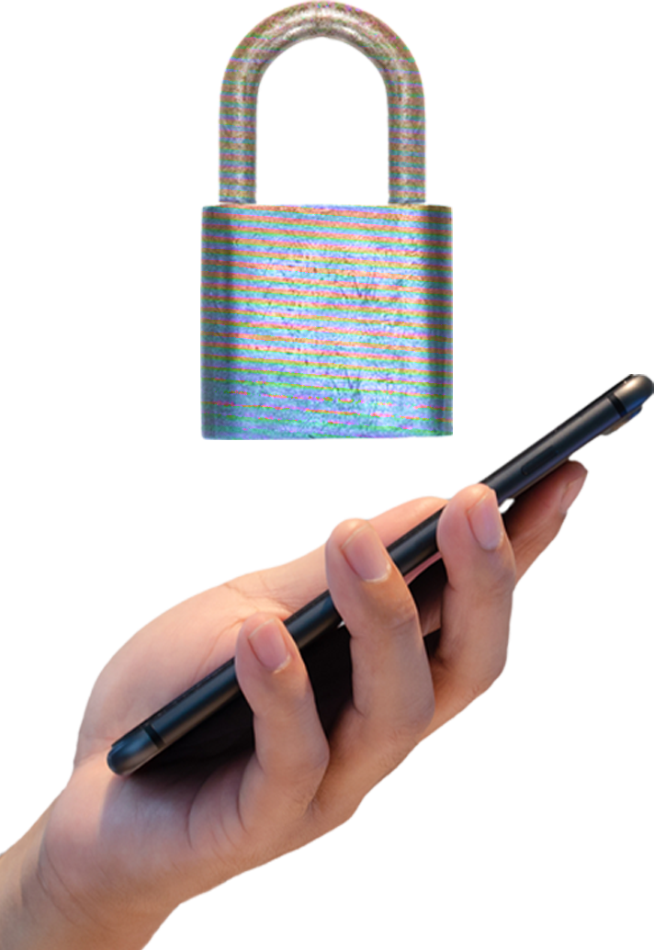

MOBILE
SECURITY
BE CAREFUL
of the 2 types of phish that specifically target your phone: SMISHING and VISHING
The BIGGEST RED FLAG for these is that they often come with a sense of urgency. When in doubt, trust your gut!
of organizations have recently experienced mobile-related compromise
- Verizon's 2022 Mobile Security Index
When charging your device on the go, use a CHARGING BLOCK or PORTABLE BATTERY to avoid catching a case of malware.
CYBERCRIMINALS use public USB ports and charging stations to upload malware onto devices and steal data.
Always remember to TALK:
TRUST only 1st party apps
AVOID public Wi-Fi by using hotspots or cellular data
LOCK your phone with a strong passcode
KEEP your device updated

